Slide 1
Trump Rally Speech Analysis
A Natural Language Processing Approach
Author: Mohammad Adi Amirudin

Slide 2
Intro |
NLP & Project Goals
NLP
NLP (Natural Language Processing) is one of the Machine Learning field that enables machines to understand human natural language, e.g., conversation, twitter chat, kids story book.
The purpose of this project is to present insights from the models.
This project has no and not affiliated by any political interest. This project did not represent my political views.

Slide 3
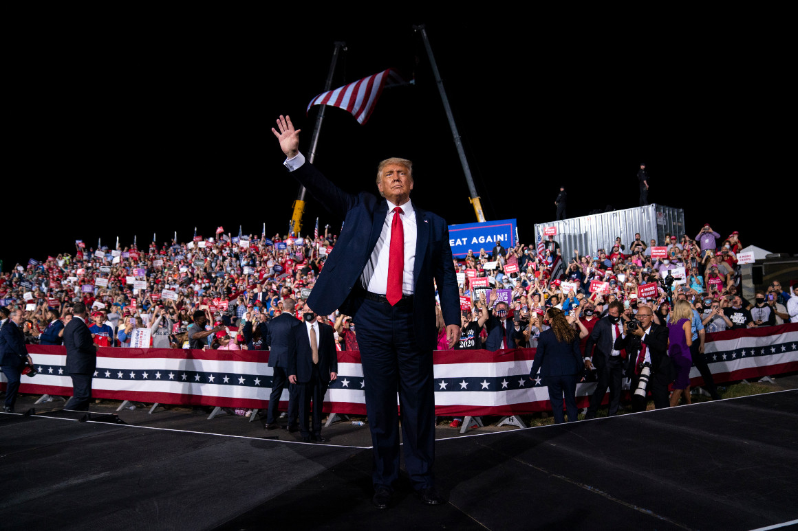
Project Details
Intro |
Project Details
Method: Machine Learning (Natural Language Processing) | Python 3.9
Dataset: Trump Rally Speech Dataset | Kaggle
Project Repository: addiamir/Trump_NLP | GitHub
Initial Commit: Aug 15th 2021

Slide 4
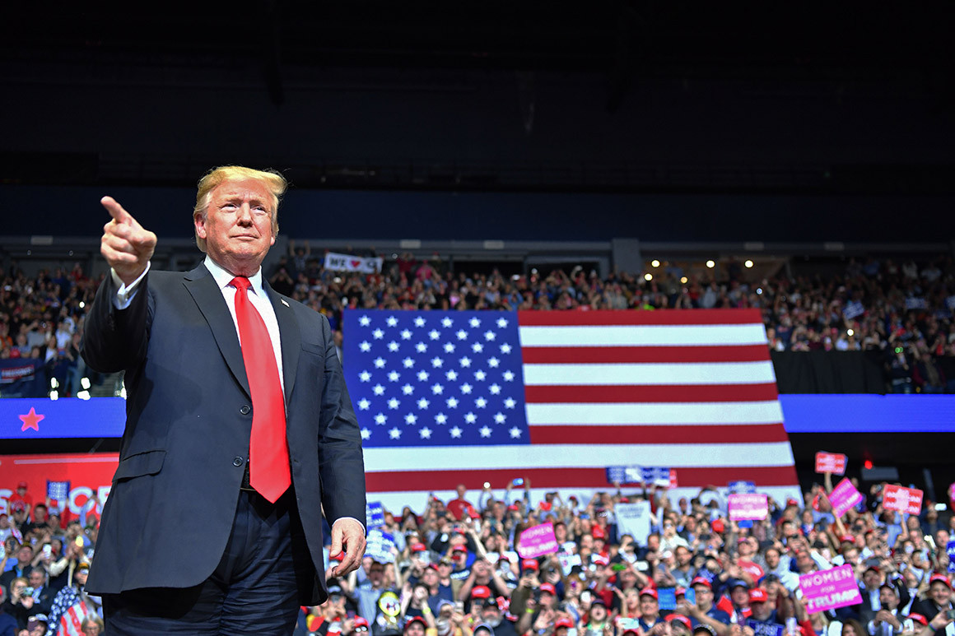















Python Packages
Intro |
Software & Packages
Data Science Software

Slide 5
Battle Creek, Dec 19th 2019
Intro |
Rally Speech Sample
Thank you. Thank you. Thank you to Vice President Pence. He's a good guy. We've done a great job together. And Merry Christmas, Michigan. Thank you, Michigan. What a victory we had in Michigan. What a victory was that. One of the greats. Was that the greatest evening? But I'm thrilled to be here with thousands of hardworking patriots as we celebrate the miracle of Christmas, the greatness of America and the glory of God. Thank you very much. And did you notice that everybody is saying Merry Christmas again? Did you notice? Saying Merry Christmas. I remember when I first started this beautiful trip, this beautiful journey, I just said to the First Lady, "You are so lucky. I took you on this fantastic journey. It's so much fun. They want to impeach you. They want to do worse than that." By the way, by the way, by the way, it doesn't really feel like we're being impeached. The country is doing better than ever before. We did nothing wrong. We did nothing wrong. And we have tremendous support in the Republican Party like we've never had before. Nobody's ever had this kind of support. But this sacred season, our country is thriving and it's thriving truly like it has never, it has never happened before to the extent what's happening now. And by the way, your state, because of us, not because of local government, but because of us, because of the job that we've done. Because I understand she's not fixing those potholes. That's what the word is. It was all about roads and they want to raise those gasoline taxes on you. We don't want to do that. But she's not fixing the potholes. But Michigan's had the best year it's ever had. Best year it's ever had. And that's because we have auto companies expanding and thriving and they're coming in from Japan and they're coming in from a lot of other places. Look what's happening. And you know, I don't know if you know this, but probably 10 years ago I was honored. I was the Man Of The Year by I think somebody, whoever. I was the Man Of The Year in Michigan. Can you believe it? Long time. And that was long before I ever decided to do this. I was happy. I had a beautiful life. What the hell did I do this for? But look how we're doing. Do we love it? I love it. But anyway, I was the Man Of The Year and probably close to 10 years ago and I came to Michigan. He said, "You're still the Man Of The Year." Thank you. Who said that? Thank you. So I came in and I remember the speech so well. I said, "Why are you allowing them to steal your car companies? Why are you allowing them to go to Mexico and to go from China where they come in from China, they build them in China, they sell them into our country with no tax and you lose your jobs, you lose your factories, the companies leave and you get nothing. Why are they lying?" I asked that a long time ago and we stopped it. We've stopped it. And you see that. And we just made the USMCA. We're getting rid of NAFTA, which I think is the worst trade deal ever. And it's very exciting. It's a great deal. It's a great deal. It's going to stop exactly what we were just talking about. It makes it very, very prohibitive. They can do it, but they've got to pay a hell of a big price to do it. And history has proven that stops them. But we have a great USMCA that we negotiated with Mexico, with Canada. Now, from the standpoint of the farmers, you know what's going on. We had tremendous trade barriers in Canada. We had attacks on dairy products, 297% tariff, nobody talked about it, with Canada. And we had some really bad things with Mexico. We now have a wonderful deal. And if we didn't have a good deal, you know what I would have done what? What? I would have put tariffs on both countries and that would have been it, right? That would have been it. Unfortunately the deal's been sitting with Nancy Pelosi for a long time and what happened? And she had a lot of pressure, especially from manufacturing areas, farm areas, a lot of pressure to sign it. So here's what happens. So I get along with labor. I had a lot of union labor vote for me, tremendous amount of labor. In New York where I come from, we have a lot of unions.
Rally Speech Sample: Battle Creek, Michigan
Thank you. Thank you. Thank you to Vice President Pence. He's a good guy. We've done a great job together. And Merry Christmas, Michigan. Thank you, Michigan. What a victory we had in Michigan. What a victory was that. One of the greats. Was that the greatest evening? But I'm thrilled to be here with thousands of hardworking patriots as we celebrate the miracle of Christmas, the greatness of America and the glory of God. Thank you very much. And did you notice that everybody is saying Merry Christmas again? Did you notice? Saying Merry Christmas. I remember when I first started this beautiful trip, this beautiful journey, I just said to the First Lady, "You are so lucky. I took you on this fantastic journey. It's so much fun. They want to impeach you.

Slide 6
Text Preprocessing
Text Preprocessing |
Tokenization, Stopwords Removal, Lemmatization
Thank you. Thank you. Thank you to Vice President Pence. He's a good guy. We've done a great job together. And Merry Christmas, Michigan. Thank you, Michigan. What a victory we had in Michigan. What a victory was that. One of the greats. Was that the greatest evening? But I'm thrilled to be here with thousands of hardworking patriots as we celebrate the miracle of Christmas, the greatness of America and the glory of God. Thank you very much. And did you notice that everybody is saying Merry Christmas again? Did you notice? Saying Merry Christmas. I remember when I first started this beautiful trip, this beautiful journey, I just said to the First Lady, "You are so lucky. I took you on this fantastic journey. It's so much fun. They want to impeach you. They want to do worse than that." By the way, by the way, by the way, it doesn't really feel like we're being impeached. The country is doing better than ever before. We did nothing wrong. We did nothing wrong. And we have tremendous support in the Republican Party like we've never had before. Nobody's ever had this kind of support. But this sacred season, our country is thriving and it's thriving truly like it has never, it has never happened before to the extent what's happening now. And by the way, your state, because of us, not because of local government, but because of us, because of the job that we've done. Because I understand she's not fixing those potholes. That's what the word is. It was all about roads and they want to raise those gasoline taxes on you. We don't want to do that. But she's not fixing the potholes. But Michigan's had the best year it's ever had. Best year it's ever had. And that's because we have auto companies expanding and thriving and they're coming in from Japan and they're coming in from a lot of other places. Look what's happening. And you know, I don't know if you know this, but probably 10 years ago I was honored. I was the Man Of The Year by I think somebody, whoever. I was the Man Of The Year in Michigan. Can you believe it? Long time. And that was long before I ever decided to do this. I was happy. I had a beautiful life. What the hell did I do this for? But look how we're doing. Do we love it? I love it. But anyway, I was the Man Of The Year and probably close to 10 years ago and I came to Michigan. He said, "You're still the Man Of The Year." Thank you. Who said that? Thank you. So I came in and I remember the speech so well. I said, "Why are you allowing them to steal your car companies? Why are you allowing them to go to Mexico and to go from China where they come in from China, they build them in China, they sell them into our country with no tax and you lose your jobs, you lose your factories, the companies leave and you get nothing. Why are they lying?" I asked that a long time ago and we stopped it. We've stopped it. And you see that. And we just made the USMCA. We're getting rid of NAFTA, which I think is the worst trade deal ever. And it's very exciting. It's a great deal. It's a great deal. It's going to stop exactly what we were just talking about. It makes it very, very prohibitive. They can do it, but they've got to pay a hell of a big price to do it. And history has proven that stops them. But we have a great USMCA that we negotiated with Mexico, with Canada. Now, from the standpoint of the farmers, you know what's going on. We had tremendous trade barriers in Canada. We had attacks on dairy products, 297% tariff, nobody talked about it, with Canada. And we had some really bad things with Mexico. We now have a wonderful deal. And if we didn't have a good deal, you know what I would have done what? What? I would have put tariffs on both countries and that would have been it, right? That would have been it. Unfortunately the deal's been sitting with Nancy Pelosi for a long time and what happened? And she had a lot of pressure, especially from manufacturing areas, farm areas, a lot of pressure to sign it. So here's what happens. So I get along with labor. I had a lot of union labor vote for me, tremendous amount of labor. In New York where I come from, we have a lot of unions.
Using Gensim, & NLTK
Tokenization
Break into readable format (words, bigram)
Thank you. Thank you. Thank you to Vice President Pence. He's a good guy. We've done a great job together. And Merry Christmas, Michigan. Thank you, Michigan. What a victory we had in Michigan. What a victory was that. One of the greats. Was that the greatest evening? But I'm thrilled to be here with thousands of hardworking patriots as we celebrate the miracle of Christmas, the greatness of America and the glory of God. Thank you very much. And did you notice that everybody is saying Merry Christmas again? Did you notice? Saying Merry Christmas. I remember when I first started this beautiful trip, this is a beautiful journey, I just said to the First Lady, "You are so lucky. I took you on this fantastic journey. It's so much fun. They want to impeach you.
Lemmatization
Process words into its base form.
Stopwords Removal
Removing common words.

Slide 7
Lexical Diversity
Feature Extraction |
Lexical Diversity, Named Entities, Sentiment Analysis, Topic Modeling
Using NLTK
Trained using Spacy
Named Entities
90
5
48
Avg.
Unique stem words per speech.
Avg. Geo Location
Mentioned
Avg. Unique People
Mentioned
Avg. Monetary
Mentioned
0.167975026

Slide 8
Feature Extraction |
Lexical Diversity, Named Entities, Sentiment Analysis, Topic Modeling
Model trained using NLTK
Model trained using NLTK & Scikit-Learn
Sentiment Analysis
Topic Modeling
Method:
Term vector: Count Vectorizer
Output: 3 sentiment:
(Positive, Negative, Neutral)
Model: Non-Negative Matrix Factorization (NMF)
Output: 10 main topics reduced to top 3 topics

Slide 9


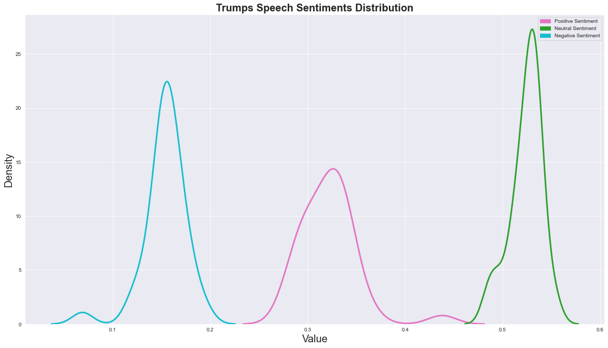
Result & Discussion |
Sentiment Distribution, Topics Dictionary, Exploratory Data Analysis
Model trained using NLTK
Sentiment Distribution
Positive
14/35 speech accentuate positive sentiments. Sentiment intensity is intermediate.
Neutral
Speech majority implying neutral sentiments. Sentiment intensity is high.
Negative
Negative sentiment denser than positive sentiments. Sentiment intensity is high.

Slide 10

Result & Discussion |
Sentiment Distribution, Topics Dictionary, Strategy Breakdown
Model trained using NLTK & Scikit-Learn
Topic Dictionary
Topic 1 | Achievements
Topic 2 | Plans, Vision & Appealing to Support
Topic 3 | Political Adversaries
say, know, don’t, people, right, great, like, think, want, year, good, just, time, make, guy, come, lot, thing, win, look, president, big, tell, okay, remember, sir, way, country, bad
great, want, people, know, american, say, year, country, new, don’t, thank, state, right, come, win, america, like, make, democrat, job, love, good, think, time, republican, work, happen, president, party, way
say, biden, know, great, want, don’t, people, like, year, job, think, right, good, win, happen, china, country, thing, just, joe, state, thank, look, make, way, america, let, bad, american, guy

Slide 11
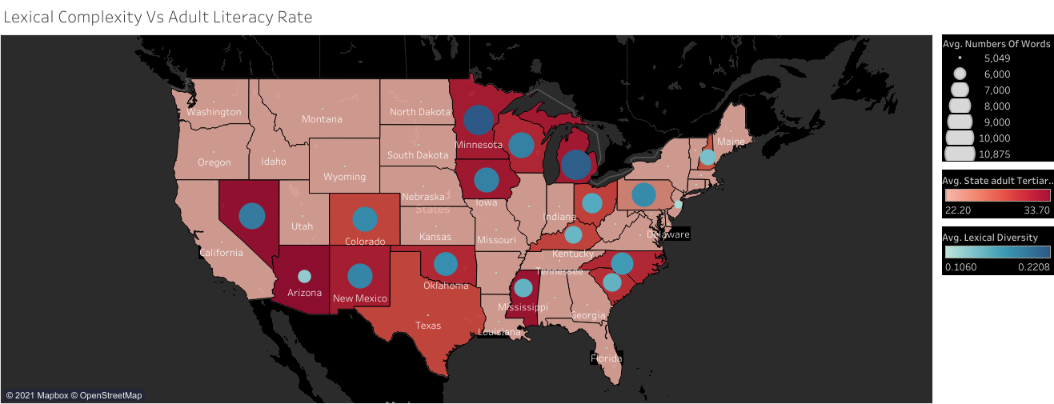
Result & Discussion |
Sentiment Distribution, Topics Dictionary, Strategy Breakdown
Strategy Breakdown
Lexical Complexity & Adult Literacy Rate
Complexity Adjustment
Trump speeches tends to be longer and more complex in states with higher level of adult literacy.

Slide 12
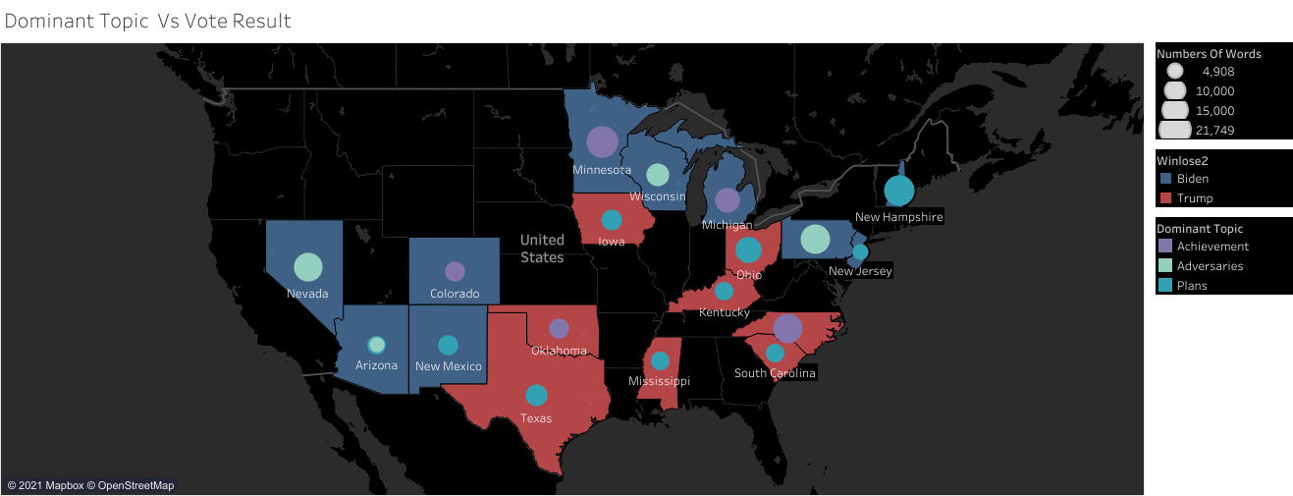
Result & Discussion |
Sentiment Distribution, Topics Dictionary, Strategy Breakdown
Strategy Breakdown
Dominant Topic & General Election Results
Effective Topic
Plans, vision and appealing seems to be the dominant topic in Trump winning states (popularity votes)
Majority Winner:
Trump
Biden

Slide 13
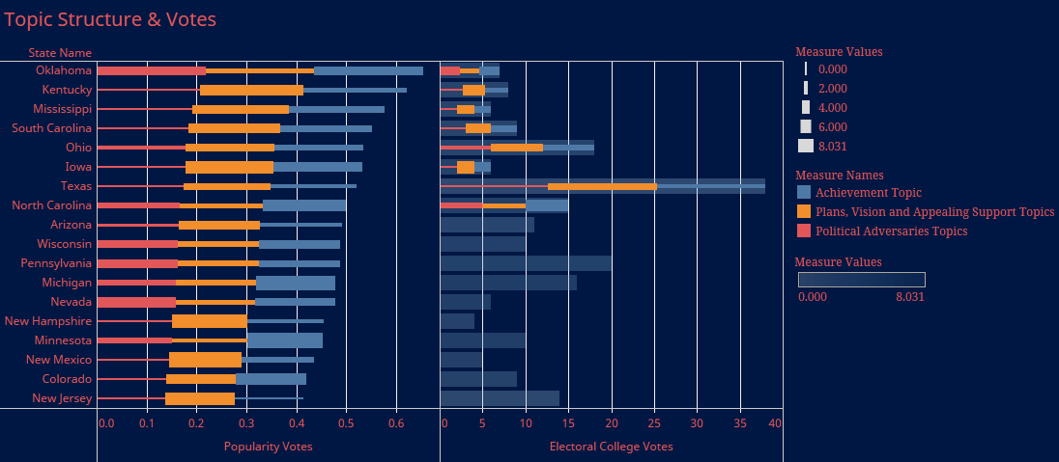
Result & Discussion |
Sentiment Distribution, Topics Dictionary, Strategy Breakdown
Strategy Breakdown
Topic Structure & Votes (Popularity + Electoral College)
Attacking Political Adversaries?
Attacking political adversaries seems to be having less impact than talking about vision or bragging about achievements.
Topic Value:
Topics:

Slide 14
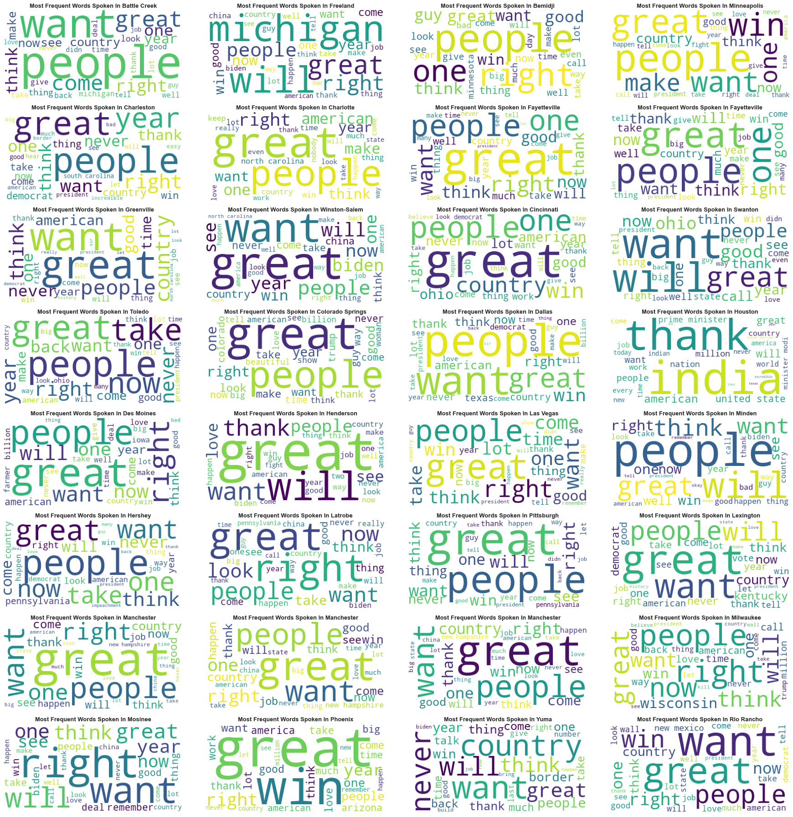
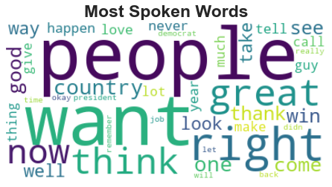
Result & Discussion |
Sentiment Distribution, Topics Dictionary, Strategy Breakdown
Strategy Breakdown
Most Spoken Words (Top 30 Words)
Breakdown in 28 Rallies
Persistent Message
People, Great, Want, Will. Speeches advocating persistent message (Plans & Vision topics)
In All Rallies

Slide 15
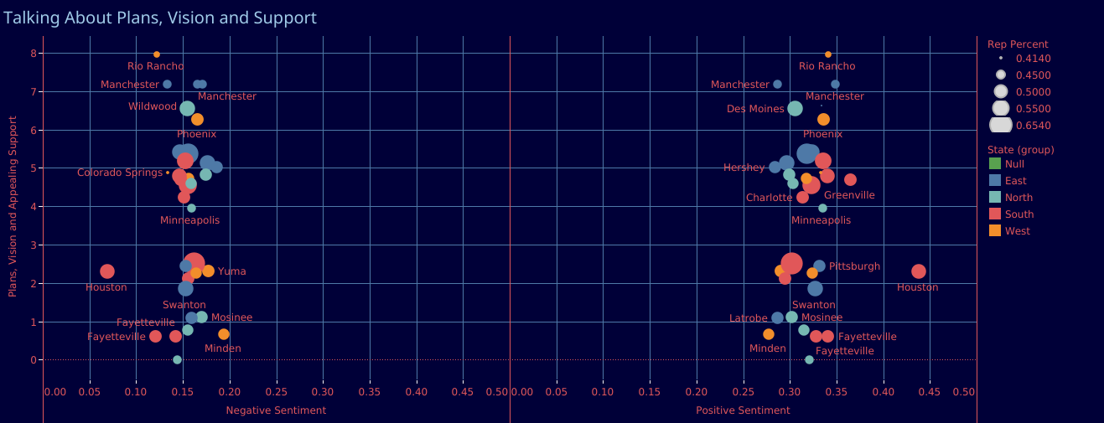
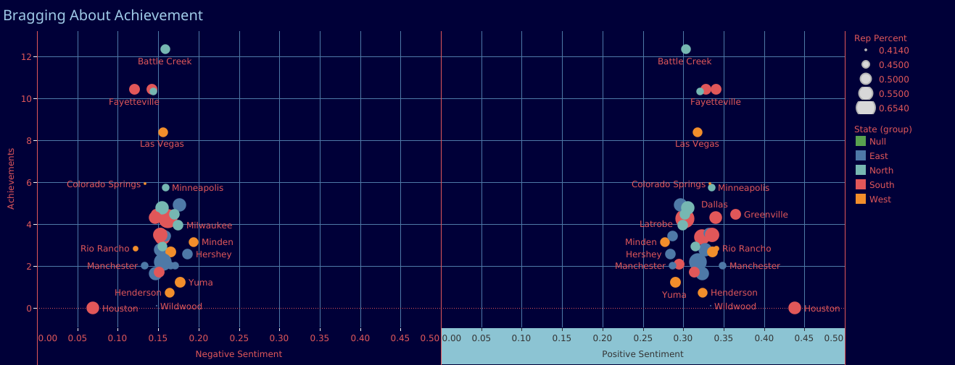
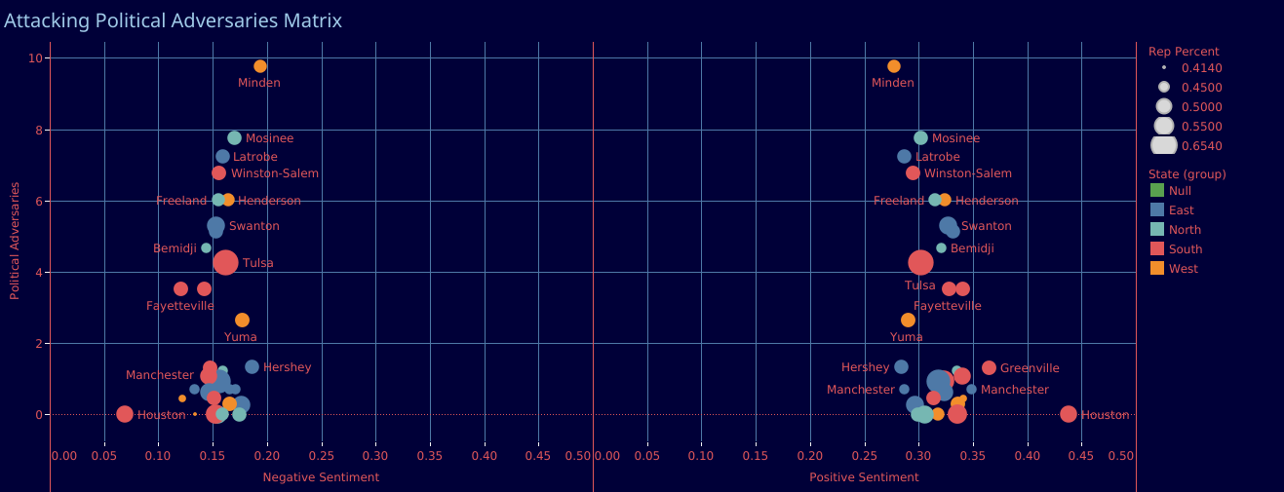
Result & Discussion |
Sentiment Distribution, Topics Dictionary, Strategy Breakdown
Strategy Breakdown
Topics & Sentiments Matrices
South & West
Topics & Sentiments value tends to increase in south and west U.S.
Play it Safe
Trump opt to amplify positive messages in each topic than curses & bad mouthing.

Slide 16
Topics & Sentiment Matrices|
Attacking Political Adversaries

Slide 17
Topics & Sentiment Matrices|
Bragging About Achievements

Slide 18
Topics & Sentiment Matrices|
Talking About Plans, Vision & Support

Slide 19
Python Scripts
Outro |
Python Scripts
# Import Library
import nltk as nltk
import os
import pandas as pd
import numpy as np
import matplotlib.pyplot as plt
import seaborn as sns
import re
import string
import spacy as sp
import matplotlib.patches as mpatches
import plotly
import plotly.offline as pyo
pyo.init_notebook_mode()
import plotly.graph_objs as go
import plotly.figure_factory as ff
from sklearn.feature_extraction.text import CountVectorizer
from sklearn.decomposition import NMF
from gensim.parsing.preprocessing import remove_stopwords
from wordcloud import WordCloud
from wordcloud import WordCloud,STOPWORDS
from nltk.sentiment.vader import SentimentIntensityAnalyzer
from nltk.sentiment import vader
from nltk.tokenize import RegexpTokenizer
from nltk.util import ngrams
from nltk.tag import pos_tag
from nltk.chunk import ne_chunk
from nltk.stem import WordNetLemmatizer
from nltk.corpus import wordnet
from nltk.corpus import stopwords
from nltk import word_tokenize
from scipy import stats
from heapq import nlargest
sns.set_style('darkgrid’)
#Import Dataset (Trump Rally Text as Corpus)
corpus = []
for dirname, _, filenames in os.walk("Trump_Rally_Speech_Text_Corpora/"):
for filename in filenames:
with open((os.path.join(dirname, filename)), encoding="UTF-8") as file_input: corpus.append(file_input.read(),)
# Creating Main Dataframe
place_name = [i.replace(".txt"," ") for i in filenames]
months = ["Jan", "Feb", "Mar", "Apr", "May", "Jun", "Jul", "Aug", "Sep", "Oct", "Nov", "Dec"]
place, month_list, date = [],[],[]
for name in place_name:
index= -1
for month in months:
index =name.find(month)
if index != -1:
month_list.append(month)
break
place.append(name[:index])
date.append(name[index+3:]) trump_df = pd.DataFrame({"Month":month_list,"Year":date,"City":place, "Speech":corpus})
trump_df[['Day','Year']] = trump_df.Year.str.split("_",expand=True,) trump_df["City"] = trump_df["City"].str.replace( r"([A-Z])", r" \1").str.strip()
trump_df["City"] = trump_df["City"].replace("Winston- Salem", "Winston-Salem")
trump_df.head(5)
# Importing Other Dataset (State List)
metrics1_df = pd.read_csv("list.csv",keep_default_na=False, na_values=[""])
metrics2_df = pd.read_csv("other data.csv",keep_default_na=False, na_values=[""])
metrics3_df = pd.read_csv("Race Data.csv",keep_default_na=False, na_values=[""])
metrics3_df = metrics3_df.drop(["IndianTotalPerc", "AsianTotalPerc", "HawaiianTotalPerc"], axis = 1)
metrics4_df = pd.read_csv("uscities.csv",keep_default_na=False, na_values=[""])
metrics4_df = metrics4_df.drop(["county_fips", "county_name", "density","source","military","incorporated","timezone","ranking","zips","id"], axis = 1)
metrics5_df = pd.read_csv("us_states_geo_loc.csv",keep_default_na=False, na_values=[""])
metrics5_df[['State','CCode']] = metrics5_df.State.str.split(", ",expand=True,)
metrics5_df = metrics5_df.drop("CCode", axis = 1)
# Merging Dataset
merged_inner = pd.merge(left=trump_df, right=metrics1_df, left_on="City", right_on="City", how="left")
merged_inner = pd.merge(left=merged_inner, right=metrics2_df, left_on="State", right_on="Row Labels")
merged_inner = merged_inner.drop("Row Labels", axis = 1)
merged_inner = pd.merge(left=merged_inner, right=metrics3_df, on= ["State"], how="inner")
merged_inner = pd.merge(left=merged_inner, right=metrics4_df, left_on=["City","State"], right_on=["city_ascii","state_name"])
merged_inner = merged_inner.drop(["city_ascii", "state_name", "state_id"], axis = 1)
merged_inner = pd.merge(left=merged_inner, right=metrics5_df, on= ["State"], how="inner")
trump_df = merged_inner.drop(merged_inner.index[[7,9,27,28,30,31,33,34]])

Slide 20
Python Scripts
Outro |
Python Scripts
# Preprocessing Data
## Tokenization
trump_df["Speech"] = trump_df["Speech"].apply(lambda x: re.sub(r'\[.*?\]','',x))
trump_df["Speech"] = trump_df["Speech"].apply(lambda x: x.lower())
tokenizer = RegexpTokenizer("[a-z][a-z]+[a-z]")
def nltk_tag_to_wordnet_tag(nltk_tag):
if nltk_tag.startswith("J"):
return wordnet.ADJ
elif nltk_tag.startswith("V"):
return wordnet.VERB
elif nltk_tag.startswith("N"):
return wordnet.NOUN
elif nltk_tag.startswith("R"):
return wordnet.ADV
else:
return None
## Lemmatization | Stopword Removal
def lemmatize_sentence(sentence):
tokenizer = RegexpTokenizer('[a-z][a-z]+[a-z]')
nltk_tagged = nltk.pos_tag(tokenizer.tokenize(sentence))
wordnet_tagged = map(lambda x: (x[0], nltk_tag_to_wordnet_tag(x[1])), nltk_tagged)
lemmatized_sentence = []
for word, tag in wordnet_tagged:
if tag is None:
lemmatized_sentence.append(word)
else:
lemmatized_sentence.append(WordNetLemmatizer().lemmatize(word, tag))
return " ".join(lemmatized_sentence)
trump_df["Speech"] = trump_df["Speech"].apply(lambda x: lemmatize_sentence(x))
trump_df["Speech_No_Stopwords"] = trump_df["Speech"].apply(lambda x: remove_stopwords(x))
# Natural Language Processing | Linguistic Feature Extractions
### Words Extraction
trump_df["Numbers Of Words"] = trump_df["Speech"].apply(lambda x: len(x.split(" ")))
trump_df["Numbers Of StopWords"] = trump_df["Speech"].apply(lambda x: len([word for word in x.split(" ") if word in list(STOPWORDS)]))
trump_df["Average Word Length"] = trump_df["Speech"].apply(lambda x: np.mean(np.array([len(va) for va in x.split(" ") if va not in list(STOPWORDS)])))
trump_df["Speech"] = trump_df["Speech"].apply(lambda x: re.sub(r"[,.;@#?!&$]+", " ", x))
### Lexical Diversity
def lexical_diversity(text):
return (len(text) / len(set(text))/10000)
trump_df["Lexical Diversity"] = trump_df["Speech"].apply(lambda x: lexical_diversity(x))
### Named Entities
nlpspacy = sp.load("en_core_web_sm")
trump_df["Numbers of Geo Location Mentioned"] = trump_df["Speech"].apply(lambda x: len([tok for tok in nlpspacy(x).ents if tok.label_ == "GPE" ]))
trump_df["Numbers of Monetary Keywords Mentioned"] = trump_df["Speech"].apply(lambda x: len([tok for tok in nlpspacy(x).ents if tok.label_ == "MONEY" ]))
trump_df["Numbers of Peoples' Name Mentioned"] = trump_df["Speech"].apply(lambda x: len([tok for tok in nlpspacy(x).ents if tok.label_ == "PERSON" ]))
## Sentiment Analysis
### Sentiment Intensity Analyzer
sid = SentimentIntensityAnalyzer()
trump_df["Sentiments"] = trump_df["Speech_No_Stopwords"].apply(lambda x: sid.polarity_scores(x))
trump_df["Positive Sentiment"] = trump_df["Sentiments"].apply(lambda x: x["pos"])
trump_df["Neutral Sentiment"] = trump_df["Sentiments"].apply(lambda x: x["neu"])
trump_df["Negative Sentiment"] = trump_df["Sentiments"].apply(lambda x: x["neg"])
trump_df.drop(columns=["Sentiments"],inplace=True)
trump_df.head(5)
### Sentiment Distribution
pink = mpatches.Patch(color='tab:pink', label='Positive Sentiment')
green = mpatches.Patch(color='tab:green', label='Neutral Sentiment')
cyan = mpatches.Patch(color='tab:cyan', label='Negative Sentiment')
plt.figure(figsize=(20,11))
ax = sns.kdeplot(trump_df['Positive Sentiment'],lw=3, label = "Positive Sentiment", color= "tab:pink")
ax = sns.kdeplot(trump_df['Neutral Sentiment'],lw=3, label = "Neutral Sentiment", color= "tab:green")
ax = sns.kdeplot(trump_df['Negative Sentiment'],lw=3, label = "Negative Sentiment", color= "tab:cyan")
ax.set_xlabel('Value',fontsize=20)
ax.set_ylabel('Density',fontsize=20)
ax.set_title('Trumps Speech Sentiments Distribution',fontsize=20,fontweight='bold')
plt.legend(handles=[pink, green, cyan])
plt.show()

Slide 21
Python Scripts
Outro |
Python Scripts
## Topic Modelling (Non-Negative Matrix Factorization)
### Terms Vectorizing
cvec_ = CountVectorizer(stop_words ="english")
doc_term = cvec_.fit_transform(list(trump_df['Speech']))
countvec = cvec_.fit(list(trump_df['Speech']))
trump_ft = pd.DataFrame(doc_term.toarray().round(3), index=[i for i in trump_df['City']], columns=cvec_.get_feature_names()).head(10)
trump_ft
### Fitting NMF Model with Terms Vector
nmf_model = NMF(n_components = 3, random_state=123)
model = nmf_model.fit(doc_term)
trump_topic = model.transform(doc_term) topic_word = pd.DataFrame(nmf_model.components_.round(3),
index = ["topic_1","topic_2","topic_3"],
columns = cvec_.get_feature_names())
topic_word
### Generating Main Topics
def display_topics(model, feature_names, no_top_words, topic_names=None):
for ix, topic in enumerate(model.components_):
if not topic_names or not topic_names[ix]:
print("\nTopic ", ix)
else:
print("\nTopic: '",topic_names[ix],"'")
print(", ".join([feature_names[i]
for i in topic.argsort()[:-no_top_words - 1:-1]]))
display_topics(nmf_model, cvec_.get_feature_names(), 30) topic_ = []
feature_ = cvec_.get_feature_names()
for ix, topic in enumerate(nmf_model.components_):
topic_.append(" ".join([feature_[i] for i in topic.argsort()]))
### Creating Topic Database
topic_df = pd.DataFrame(trump_topic.round(3),
index = [i for i in trump_df['City']],
columns = ["topic_1","topic_2","topic_3"])
topic_df.head(5) topic_df = topic_df.reset_index()
### Merging Topic With Main Dataframe
trump_df = pd.merge(left=trump_df, right=topic_df, left_on="City", right_on="index")
trump_df = trump_df.drop("index", axis = 1)
trump_df.head(4)
# Data Visualization | Word Cloud | Most Frequent Words Spoken (All Rallies Combined)
topwords_plus = set(STOPWORDS)
stopwords_plus.update(["say", "go", "know", "don"])
most_words_global = " ".join(tmpwords for tmpwords in trump_df.Speech)
wordcloud = WordCloud(max_words=40, stopwords=stopwords_plus, background_color="white").generate(most_words_global)
plt.imshow(wordcloud, interpolation='bilinear')
plt.axis('off')
plt.tight_layout(pad=0)
plt.title('Most Spoken Words',fontsize=23,fontweight='bold')
plt.show()
### Most Frequent Words Spoken (Per Rallies)
fig,axes = plt.subplots(8,4)
fig.set_figwidth(25)
fig.set_figheight(25)
r,c=0,0
for cit in trump_df.City:
text = trump_df.query('City == "{}"'.format(cit))
text = ' '.join(text.Speech.values)
axes[r][c].imshow(WordCloud(max_words=25, stopwords=stopwords_plus, background_color="white").generate(text))
axes[r][c].axis('off')
axes[r][c].set_title('Most Frequent Words Spoken In {}'.format(cit),fontsize=13,fontweight='bold')
c+=1
if c == 4:
c = 0
r+=1
if r == 8:
break
plt.tight_layout()

Slide 22
Python Scripts
Outro |
Python Scripts
### Sentiments Wordcloud
#### Positive Sentiment Dictionary
pos_word_list = []
text1 = ' '.join(trump_df.Speech.values)
tokenized_sentence = text1.split(' ')
tokenized_sentence = [w for w in tokenized_sentence if w not in list(stopwords_plus)]
for word1 in tokenized_sentence:
if (sid.polarity_scores(word1)['compound']) >= 0.1:
pos_word_list.append(word1)
pos_word_list
pos_word_dict = {word1:len(re.findall(word1,text1)) for word1 in pos_word_list}
top_10_pos = nlargest(10, pos_word_dict, key=pos_word_dict.get)
#### Negative Sentiment Dictionary
neg_word_list = []
text2 = ' '.join(trump_df.Speech.values)
tokenized_sentence = text.split(' ')
tokenized_sentence = [w for w in tokenized_sentence if w not in list(stopwords_plus)]
for word2 in tokenized_sentence:
if (sid.polarity_scores(word2)['compound']) <= -0.1:
neg_word_list.append(word2)
neg_word_dict = {word2:len(re.findall(word2,text2)) for word2 in neg_word_list}
top_10_neg = nlargest(10, neg_word_dict, key=neg_word_dict.get)
#### Positive Words (Plotting)
plt.figure(figsize=(20,15), facecolor = None)
plt.imshow(WordCloud(width = 800, height = 800,background_color='white').generate(' '.join(nlargest(30, pos_word_dict, key=pos_word_dict.get))))
plt.axis('off')
plt.tight_layout(pad=0)
plt.title('Top 30 Positive Words',fontsize=23,fontweight='bold')
plt.show()
#### Negative Words (Plotting)
plt.figure(figsize=(20,15), facecolor = None)
plt.imshow(WordCloud(width = 800, height = 800,background_color='white').generate(' '.join(nlargest(30, neg_word_dict, key=neg_word_dict.get))))
plt.axis('off')
plt.tight_layout(pad=0)
plt.title('Top 30 Negative Words',fontsize=23,fontweight='bold')
plt.show()

Slide 23
Trump Rally Speech Analysis
Project Documentation: github.com/addiamir/Donald_Trump_Rally_Speech_NLP_Analysis
Author: Mohammad Adi Amirudin

